Slide 1


Driver’s Sleepiness Detection System
GUIDE :- PROF S.THEPADE
MEMBERS :-
AASIM SAYYAD
VARUN SHRIWARDHANKAR
SUDHANSHU SHUKLA
PRATIK MEHTA

Slide 2
INDEX
Introduction
Goal and Objective
Proposed System
Scope of Project
Architecture
Algorithm
Implementation
Conclusions
References

Slide 3
Introduction
We have developed system to ensure the safety of driver.
Our system detects the eye blinks of driver and estimates driver’s sleep status.
Our system wakes sleepy driver using alarm.

Slide 4
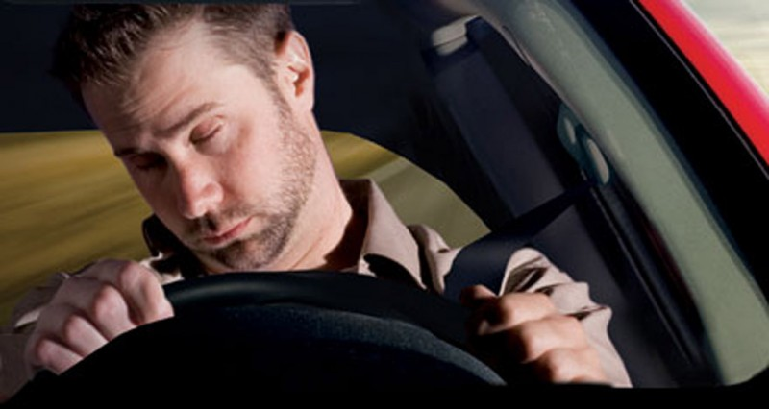
Goal and Objective
Simulate sleepiness detection system using image processing methods.
Alarming the driver so that he/she can wake up.
Prevent accidents caused due to drowsiness.

Slide 5
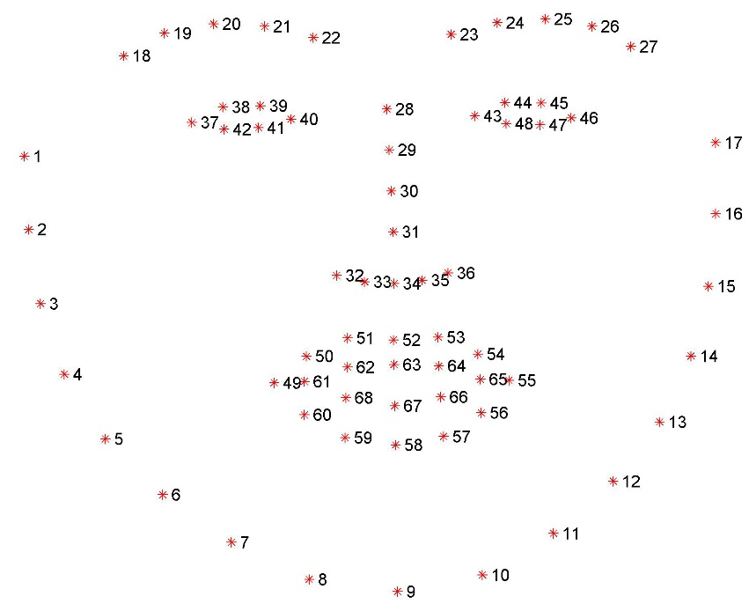
Proposed System
Use image processing techniques to determine the drowsy state of driver
If drowsy state detected alert driver and other passengers using alarm.

Slide 6
Scope of Project
Develop a system that can accurately drowsiness and make alarms accordingly.
The project is accomplished by a Raspberry pi camera that constantly takes image of driver
A raspberry board that implement image processing algorithm of sleep detection
A feedback circuit that could generate alarm and a power supply system.

Slide 7
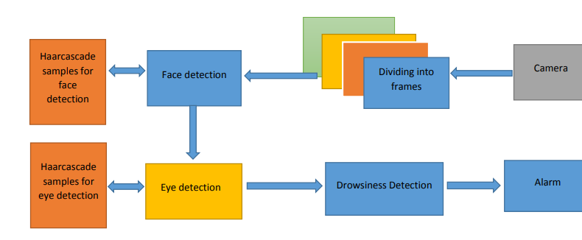
Architecture
FIG:- Architecture Diagram of Driver’s Sleep Detection System

Slide 8
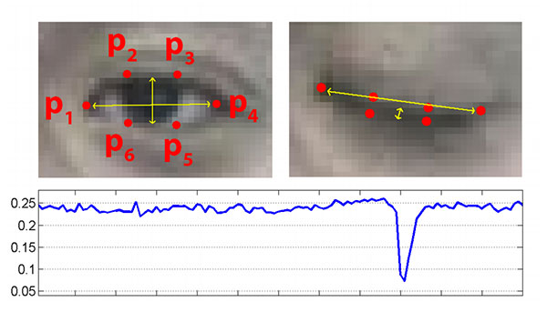
Algorithm
A raspberry pi 5MP camera placed on raspberry is continuously analysing the driver’s face during the ride.
The system analyses the driver’s eyes and if the co-ordinates comes closer then sleepiness is detected.
If the eyes are shut for more than 1/4 a second (longer than a normal blink period) then the systems beeps to alert the driver.

Slide 9
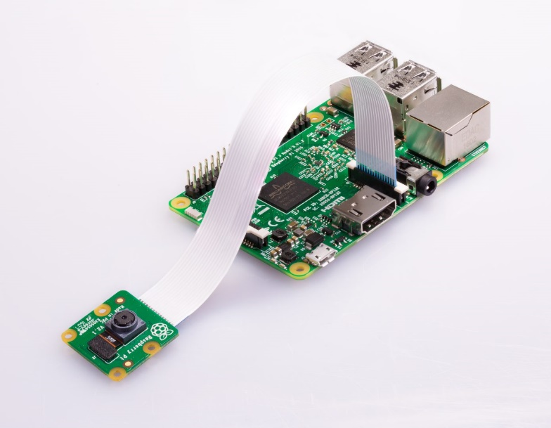
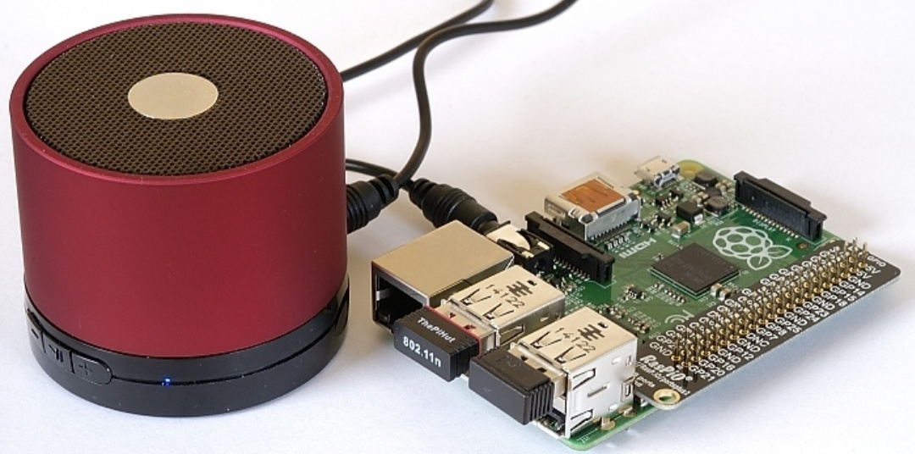
Implementation
We have used Raspberry Pi-3 and 5MP Raspberry Pi camera mounted on it.
Camera detects the drowsiness and alerts through speaker attached to the Raspberry Pi.

Slide 10
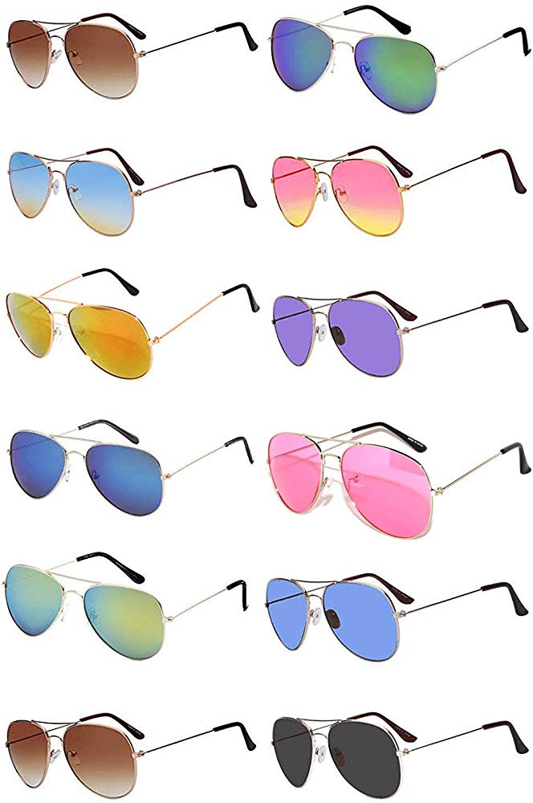
Conclusions
System detects sleepiness and alert driver through alarm sounds which will be produced through speakers.
Wearing coloured glasses (of any kind) cause the system to fail.

Slide 11
References
DROWSY DRIVING AND AUTOMOBILE CRASHES:
http://www.nhtsa.dot.gov/people/injury/drowsy_driving1/drowsy.html
Federal Motor Carrier Safety Administration:
http://www.fmcsa.dot.gov/
BGU – Introduction to Computational and Biological Vision course:
http://www.cs.bgu.ac.il/~icbv071/LectureNotes/ICBV-Lecture-Notes-41- Perceptual-Organization-1-Edge-Aggregetion-Case-Study-1SPP.pdf
http://www.thesecrettosoundsleep.com/

Slide 12


Questions?

Slide 13
Thank You

